Slide 1

HANDMADE CLOTHING ONLINE RETAILER
ARTEA
3RD SEM M.S. ANALYTICS
DATA ETHICS
SAURONIL BISWAS
M2022ANLT026 OF 2022-2026

Slide 2
PROCESS AND ANALYSIS
Exploratory Data Analysis (EDA) Process and Prediction:
Data Collection: Gathered excel sheets containing customer information, transaction history, and demographic data.
Descriptive Statistics: Calculated summary statistics (mean, median) for key variables to understand the data's distribution.
Data Visualization: Created visualizations (histograms, box plots, etc.) to assess data characteristics and identify outliers. Plotted Pie charts to analyze categorical variables like gender, minority status, etc.
Segmentation Analysis: Segmented data based on demographic factors (e.g., gender, minority status in the second sheet) to compare group differences. Analyzed conversion rates and other metrics within each segment.
Hypothesis Testing: Formulated null and alternative hypotheses related to the impact of demographics on conversions. Performed statistical tests (t-tests or ANOVA) to assess whether differences in conversion rates were statistically significant.
Feature Importance: Conducted feature importance analysis to identify variables influencing outcomes (transaction and revenue). Explored relationships between variables using Pearson correlation analysis.
Prediction: Used Machine learning techniques such as random forest classifier and random forest regression for prediction of transaction and revenue respectively.

Slide 3
MARKET TRENDS

Slide 4
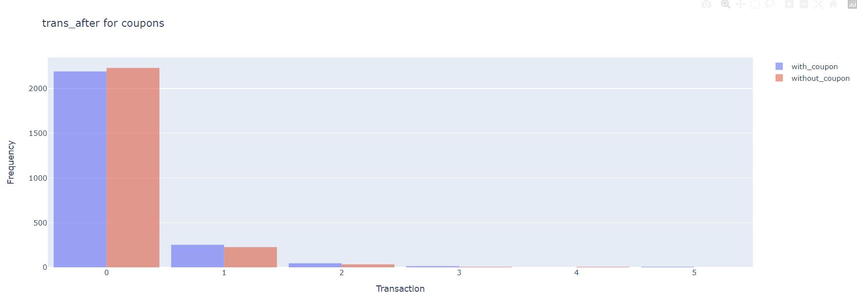
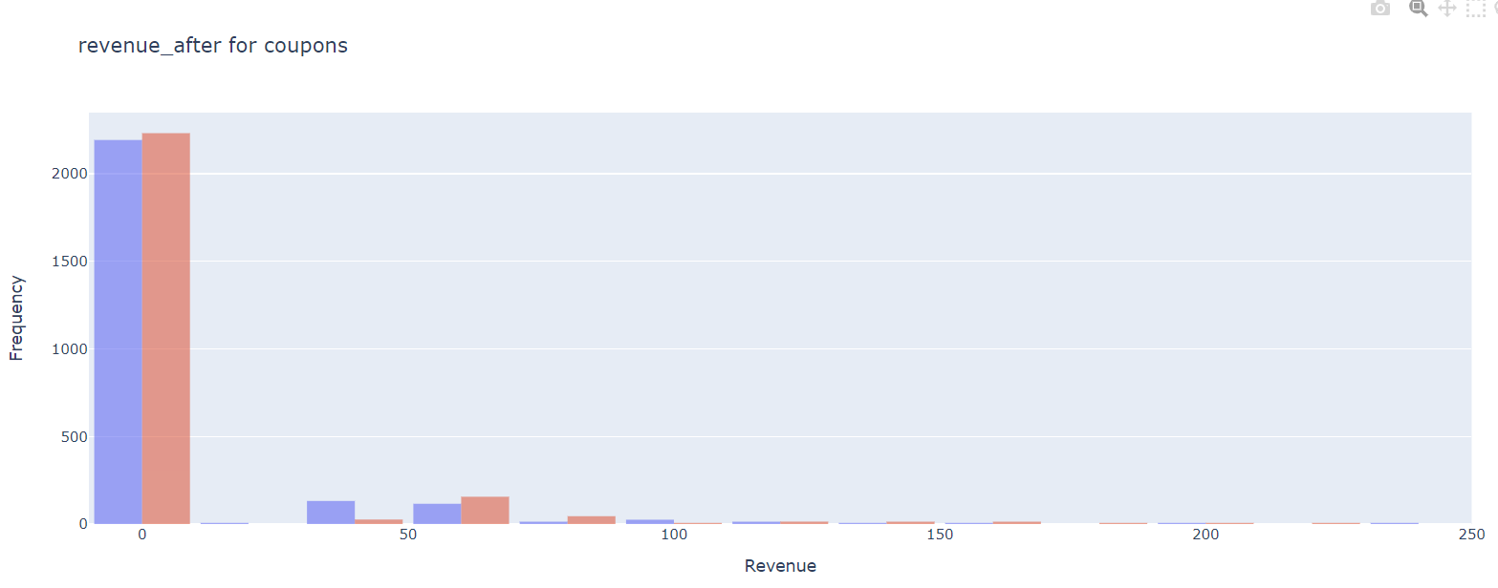

Did the coupon increase revenues? Did it increase transactions?
We can see in the above histograms that there’s not much difference between the performance in with coupons and without coupons both in case of transaction and revenue.

Slide 5
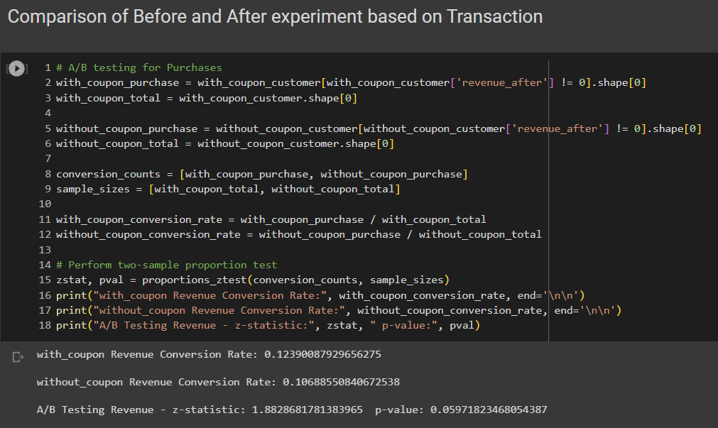
I have performed a two-sample performance test to compare the Transaction before and after the experiment:
In this case, the z-statistic is approximately 1.882. The positive z-statistic value indicates that
the Transaction rate after experiment is slightly higher than the Transaction rate before experiment.
Null Hypothesis (H0): Offering 20% discount coupons to randomly chosen customers does not significantly increase revenue.
Alternative Hypothesis (H1): Offering 20% discount coupons to randomly chosen customers significantly increases revenue.
Since the p-value is slightly greater(0.0597) than the typical significance level of 0.05 we do not have enough evidence to reject the null hypothesis.

Slide 6
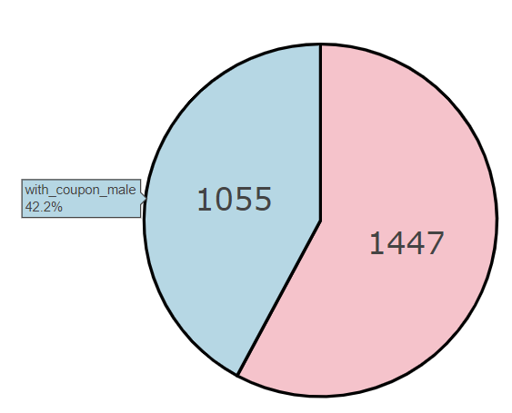
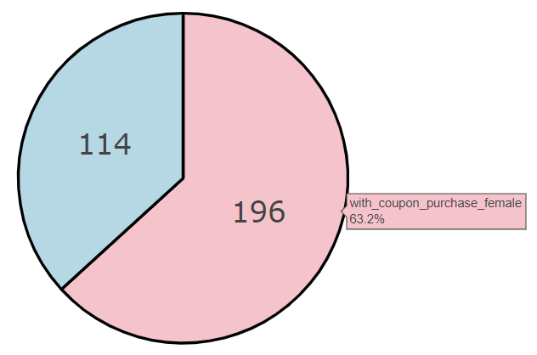

In the future, should Artea give the discount to everyone, no one, some people?
Customers with coupons who have purchased, that is 310 out of 2500 coupons distributed randomly distributed.
With coupon Female Average conversion: 63.23%
Without coupon Male Average conversion: 36.77%
With coupon Minority Average conversion: 10.65%
Without coupon Majority Average conversion: 89.35%

Slide 7
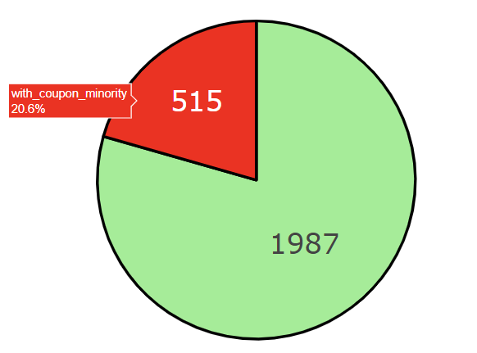
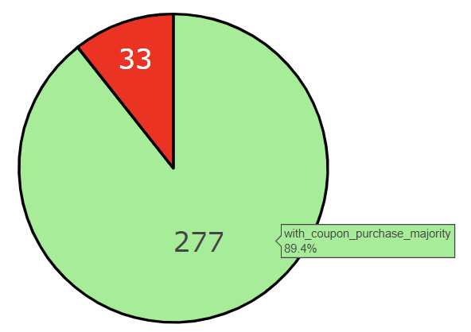
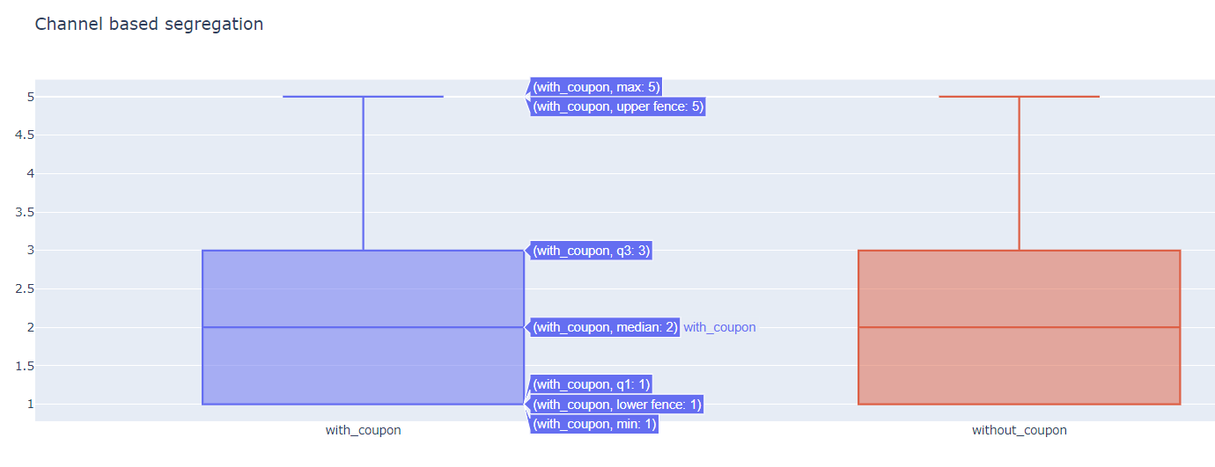

Slide 8

Which customers should be targeted in the next targeting campaign?
Female vs. Male (if we consider from business point of view)
The conversion rate for females with a coupon is 63.23%, which is significantly higher than the conversion rate for males without a coupon (36.77%).
Targeting females with coupons could be effective as they have a higher conversion rate than males.
Minority vs. Majority:
1. The conversion rate for minorities with a coupon is 10.65%, while the conversion rate for the majority group without a coupon is 89.35%.
2. It's important to note that the conversion rate for minorities is significantly lower than that of the majority group.
3. In this case, targeting minorities with coupons might not be as effective given their lower conversion rate.

Slide 9
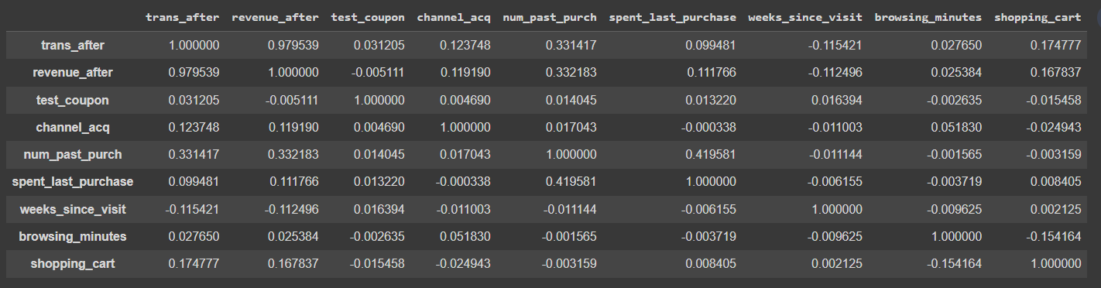
Recommendations
Target Females: Based on the provided data, females have a higher conversion rate when given a coupon. Therefore, it's recommended to target females in the next targeting campaign. You could consider providing coupons or tailored offers to this group.
Caution with Minorities: While minorities have a low conversion rate with coupons, it's important to dig deeper into the reasons behind this low conversion. If there are external factors affecting their purchasing behavior, addressing those factors could potentially improve the conversion rate.
Correlation Coefficient Among independent variables in data table from first sheet

Slide 10
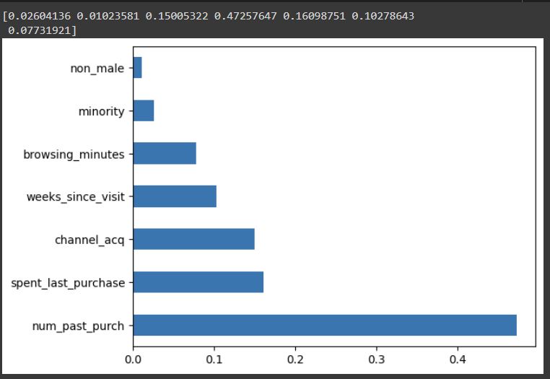
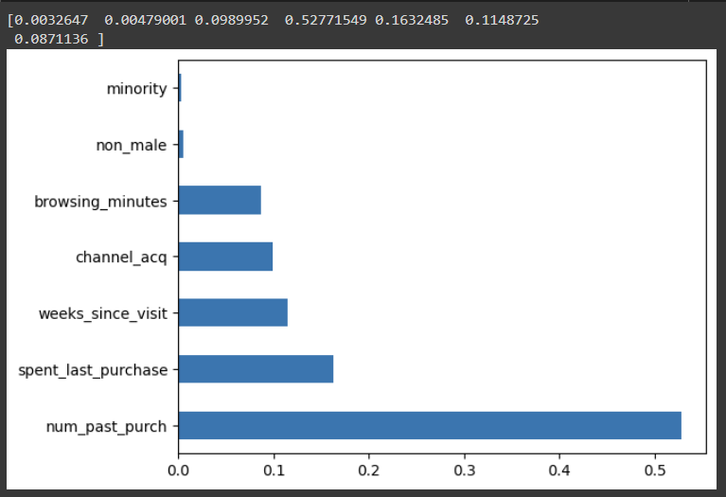
How many transactions and revenues should you expect if Artea targets those customers?
Left hand side image is the feature selection bar graph for random forest classifier
In right hand side I have featured selection graph for random forest regressor
In both the cases the column non_male and minority Both having zero and one value are of least importance according to the random forest ensemble based decision tree algorithm.

Slide 11

Transaction
Whether the transaction will happen or not that is a dichotomous output. For that reason The predicted output could not be classified properly because of inadequate data.
Revenue
Revenue being a continuous variable I could predict that a total of 44684.02 unit of revenue Will be generated according to the predictor after the second round of coupon distribution.

Slide 12
What are the risks of using your proposed targeting policy?
As we have earlier seen that distributing the coupons to female customers will be beneficial for the business. Also the majority who have received the coupon have used it substantially and contributed to the revenue generation effectively.
It is important to consider some risks to ensure that recommendations and strategies are ethical and do not inadvertently discriminate against any group. Some of the risks are:
Bias and Discrimination: Targeting policies based solely on gender, ethnicity, or other demographic factors can lead to bias and discrimination. This can result in unequal opportunities and reinforce existing inequalities.
Unintended Consequences: Focusing solely on conversion rates without understanding the underlying reasons for the disparities can lead to unintended consequences.
Reinforcing Stereotypes: It may overlook the individual preferences and behaviors of customers.
Loss of Potential Customers: By not targeting certain groups, we might miss out on potential customers who could be interested in your products but were excluded based on demographic factors.
Negative Public Perception: Adopting targeting policies can lead to negative public perception and damage the company's reputation.
Legal and Regulatory Issues: Some regions have laws and regulations against discriminatory practices in marketing and targeting. Ignoring these regulations can lead to legal repercussions.

Slide 13
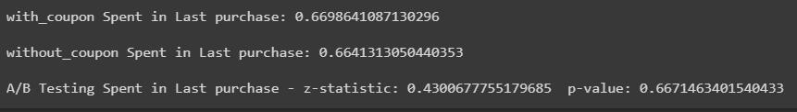

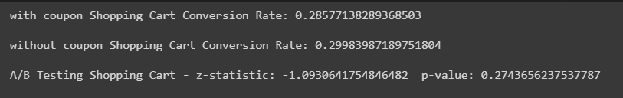
Some other important Hypothesis Tests
All of them have p value greater than the Alpha=0.05. So the results after running the experiment does not give us enough confidence to tell that randomly chosen customers who received coupons positively increased the revenue of Artea.

Slide 14

Conclusion
My analysis indicates that demographic factors impact conversion rates. Females respond positively to coupons, while minorities exhibit lower conversion rates compared to the majority.
Based on our analysis, the predicted total revenue is 44684.02 units.
Prioritizing ethical considerations is crucial in formulating strategies. Ensuring fairness and avoiding bias will align with ethical business practices.
Recommendation
When targeting females, ensure strategies remain inclusive, addressing the needs of all potential customers and avoiding stereotypes.
Delve deeper into factors causing lower conversion rates among minorities. Use groups, surveys or interviews to identify barriers and design tailored solutions.
Test different targeting approaches through A/B tests before full implementation. This iterative process refines strategies for optimal outcomes.
Acquire more comprehensive transaction data to enhance predictions and better understand the transaction-revenue relationship.
Continuously assess the impact of targeting strategies, including customer satisfaction, brand perception, and business goals.

